Slide 1
Computational Thinking
Part 3
Notes:
Continue with the next slide, no notes here :

Slide 2
Review : Case Study
Decomposition
Abstraction
Pattern Recognition
Algorithms
Notes:
We will take a look at a case study that will demonstrate these concepts for us, next slide :

Slide 3
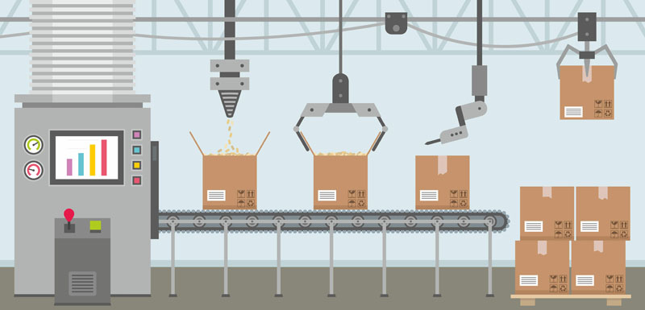
Review : Case Study
Notes:
Lets observe carefully what the case study is about.
In a fictional package delivery firm, we have a conveyor belt, a part of the internal system.
The purpose is to calculate how much the shipping will cost for each box.
Each box has a different size and weight.
Every box has an address, contact info, attached on it.
Every box has a stiffness (How much it can resist to external force).
Our conveyor belt has 2 steps:
* RGB sensor, detects the color of the box to understand the size of it. (R = 255, G=255, B=255)
* There is a load cell that measures the weight of it.
The conveyor belt gets the shape first, later the weight.
Calculation must be made : ((H + L + W) * Weight) + 1$
Save the calculated result to the DB.

Slide 4
Review : Case Study
Abstraction
Simplification by eliminating the unnecessary details that won’t be needed in the solution provided.
Which system analysis inputs can we eliminate from the final solution?
Notes:
After this slide we take a look at the inputs provided by the System Analysis.

Slide 5
Abstraction on Analysis
In a factory we have a conveyor belt, a part of the internal system.
The purpose is to calculate how much the shipping will cost for each box.
Each box has a different size and weight.
Every box has an address, contact info, attached on it.
Every box has a stiffness (How much it can resist to external force).
Our conveyor belt has 2 steps:
* RGB sensor, detects the color of the box to understand the size of it. (R = 255, G=255, B=255)
* There is a load cell that measures the weight of it.
The conveyor belt gets the shape first, later the weight.
Calculation must be made : ((H + L + W) * Weight) + 1$
Save the calculated result to the DB.
Notes:
The items highlighted could be eliminated.

Slide 6
Abstraction applied on Analysis
In a factory we have a conveyor belt, a part of the internal system.
The purpose is to calculate how much the shipping will cost for each box.
Each box has a different size and weight.
Our conveyor belt has 2 steps.
The conveyor belt gets the shape first, later the weight.
Calculation must be made : ((H + L + W) * Weight) + 1$
Save the calculated result to the DB.
Notes:
This is the first step of Abstraction, if we would like to see the analysis in more Abstract terms it would be
as in the next slide.

Slide 7
Abstraction
Input Shape => Process ((Height + Width + Length) * Weight) + 1$ => Save the result in DB.
Notes:
This is the second step of Abstraction. The analysis looks abstract enough.

Slide 8
Decomposition
In a factory we have a conveyor belt, a part of the internal system.
The purpose is to calculate how much the shipping will cost for each box.
Each box has a different size and weight.
Our conveyor belt has 2 steps.
The conveyor belt gets the shape first, later the weight.
Calculation must be made : ((H + L + W) * Weight) + 1$
Save the calculated result to the DB.
Notes:
Measuring
* First measure the size by the help of RGB Sensor
* Later measure the weight by the help of the Load Cell.
Calculate the weight based on the formula
Save the results in DB.
The decomposed flowchart is on the next page;

Slide 9
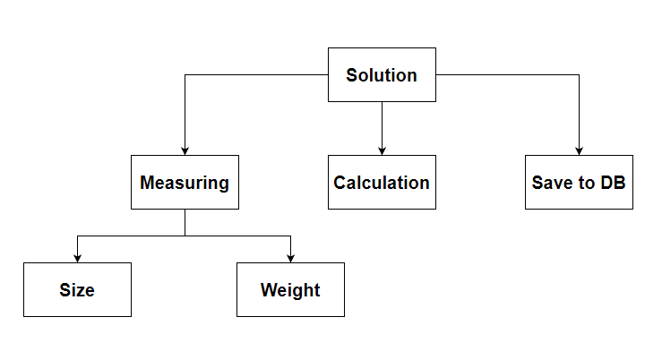
Decomposition
Notes:
Measuring
* First measure the size by the help of RGB Sensor
* Later measure the weight by the help of the Load Cell.
Calculate the weight based on the formula
Save the results in DB.

Slide 10
Pattern Recognition and Modelling
In a factory we have a conveyor belt, a part of the internal system.
The purpose is to calculate how much the shipping will cost for each box.
Each box has a different size and weight.
Our conveyor belt has 2 steps.
The conveyor belt gets the shape first, later the weight.
Calculation must be made : ((H + L + W) * Weight) + 1$
Save the calculated result to the DB.
Notes:
In order to apply Pattern Recognition we need to understand if there are some repetitive patterns here.
What do you see as a repeating pattern here?
What can be modelled to simplify the solution?
Solution:
We see the abstract analysis here in the figure. We have different shapes of boxes with different weights.
So it means we don’t have to write code (provide a solution) for each size of box here. One box can be (23,45,122) and 2000gr where other can have different shape. So we should have a model that can be used in our code as a reference. We can use this technique to shorten our solution.
Highlighted terms are suitable to apply Pattern Recognition.

Slide 11
Pattern Recognition and Modelling
We should have a common model with definition;
Package
Length : decimal
Width : decimal
Height : decimal
Weight : decimal
Notes:
If we have such a model we won’t have to write code for each individual box type.
A generic type will help us to find a generic solution.

Slide 12
Algorithm: Pseudocode, Flowchart
In order to have a solid developed algorithm we can use Pseudocode or Flowchart or both of them.

Slide 13
Pseudocode
In order to have a solid developed algorithm we can use Pseudocode or Flowchart or both of them.
Notes:
Initially we will ignore the fail-cases; We will consider the sensor outputs as always valid, next slide

Slide 14
Pseudocode
While the production line is active, conveyor belt sends new packets do the actions below;
Measure the size by the help of RGB Sensor, send it to next sensor
Measure the weight by the help of Load Cell.
Do the calculation by using formula : ((H + L + W) * Weight) + 1$
Save the results to the DB.

Slide 15
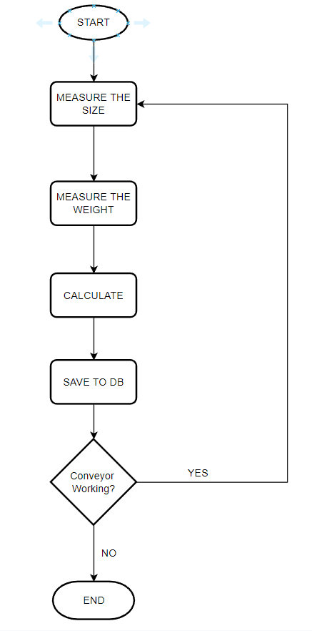
Flowchart
Notes:
In its simplest form the flowchart will look like this.
But if we also consider the situations like sensors may fail, than it will be ;

Slide 16
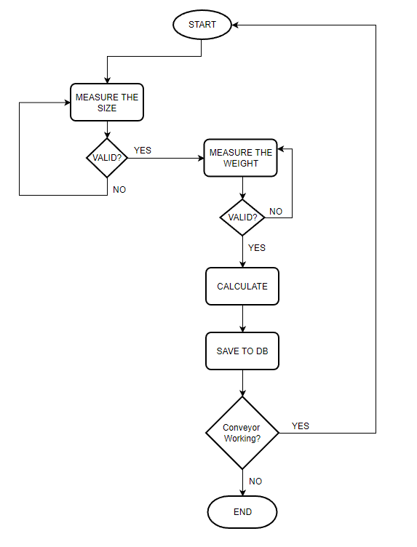
Flowchart
Notes:
When the sensors are also forced to recapture the inputs when an error occurs, the flowchart could be arranged as displayed.
Now after couple of slides later we will briefly re-consider the algorithmic definitions, general to all programming languages.
We will consider Python while evaluating the codes.

Slide 17
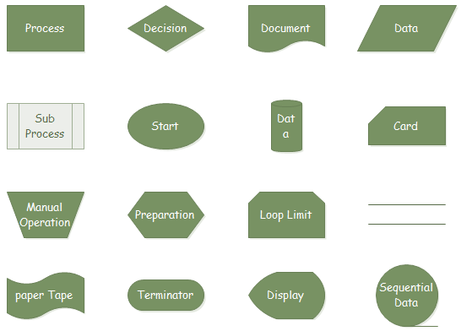
Flowchart

Slide 18
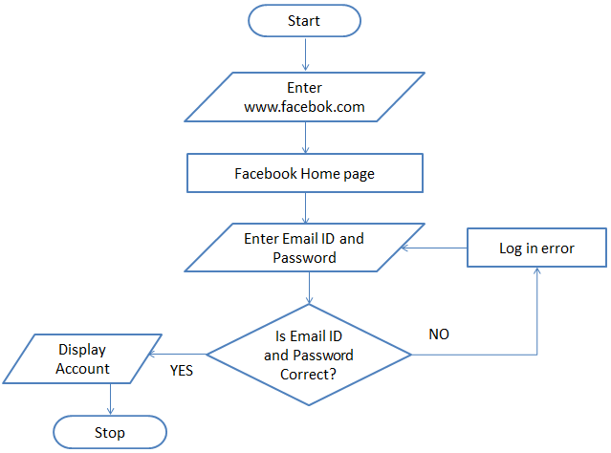
Login Diagram
A flowchart to login to facebook account:

Slide 19

Notes:
https://create.kahoot.it/details/ea4a8fc2-f304-494a-a7b0-e9564ba0173e

Slide 20
The Algorithmic Statements
Brief overview of
if - else - elif
while - for - switch:case
exception handling
class, function, Inheritance
in Phyton syntax
Discussion :
Why interfaces don’t exist?
Notes:
In python we have abstract base classes, similar implementation can be achieved by abstract classes.

Slide 21
THANKS!
Any questions?
You can find me at:
@volkan
volkan@clarusway.com

